Slide 1
CT026-3-2
Human Computer Interaction
Human Computer Interaction
Evaluation
Level 2
Prepared by: RZW First Prepared on: December, 2007 Last Modified on: Feb 2018
Quality checked by: MOH
Copyright 2004 Asia Pacific Institute of Information Technology

Slide 2
Topic & Structure of the lesson
Why evaluations?
When to evaluate?
Evaluation paradigm
DECIDE : A framework to guide evaluation
Pilot studies

Slide 3
Learning Outcomes
At the end of this lecture, you should be able to:
Describe the evaluation paradigms & techniques used in
interaction design.
Discuss the conceptual, practical and ethical issues that
must be considered when planning evaluations.
Use the DECIDE framework in your own work

Slide 4
Two Main Types of Evaluation
Formative evaluation
  It is done at different stages of development
  To check that the product meet users’ needs
  Focus on the process
Summative evaluation
- To assess the quality of a finished product
- Focus on the results

Slide 5
Two Main Types of Evaluation
“ When the cook tastes the soup, that’s formative. When the guests taste the soup, that’s summative ”

Slide 6
Iterative Evaluation
Iterative design and evaluation is a continuous process that examines:
  Early ideas for conceptual model
  Early prototypes of the new system
  Later, more complete prototypes
Evaluation enable designers to check that they understand users’ requirements
Original Product Concept
Parallel Design Sketches
First Prototype
Evaluation
Iterative Design Versions
Final Released Product

Slide 7
Why evaluation?
“Iterative design, with its repeating cycle of design and testing, is the only validated methodology in existence that will consistently produce successful results. If you don’t have user-testing as an integral part of your design process you are going to throw buckets of money down the drain.”
See www.AskTog.com for topical discussion about design and evaluation.

Slide 8
When to evaluate?
Throughout the design phases
Also at the final stage – on the finished product
Design proceeds through iterative cycles of ‘design –test – redesign’
Triangulation involves using a combination of techniques to gain different perspectives

Slide 9
Evaluation Paradigm
Any kind of evaluation is guided explicitly or implicitly by a set of beliefs, which are often under-pined by theory. These beliefs and the methods associated with them are known as an ‘evaluation paradigm’

Slide 10
Four Evaluation Paradigms
‘quick and dirty’
usability testing
field studies
predictive evaluation

Slide 11
Quick And Dirty
‘Quick & Dirty’ evaluation describes the common practice in which designers informally get feedback from users to confirm that their ideas are in-line with users’ needs and are liked.
Quick & dirty evaluations are done any time.
The emphasis is on fast input to the design process rather than carefully documented findings.

Slide 12
Usability Testing
Usability testing involves recording typical users’ performance on typical tasks in controlled settings.
As the users perform these tasks they are watched & recorded on video & their key presses are logged.
This data is used to calculate performance times, identify errors & help explain why the users did what they did.
User satisfaction questionnaires & interviews are used to elicit users’ opinions.

Slide 13
Field studies
Field studies are done in natural settings
The aim is to understand what users do naturally and how technology impacts them.
In product design field studies can be used to:
  identify opportunities for new technology
  determine design requirements
  decide how best to introduce new technology
  evaluate technology in use.

Slide 14
Predictive Evaluation
Experts apply their knowledge of typical users, often guided by heuristics, to predict usability problems.
Another approach involves theoretically based models.
A key feature of predictive evaluation is that users need not be present
Relatively quick & inexpensive

Slide 15
Evaluation Techniques
observing users
asking users’ their opinions,
asking experts’ their opinions,
testing users’ performance

Slide 16
DECIDE: An Evaluation Framework
Determine the goals the evaluation addresses.
Explore the specific questions to be answered.
Choose the evaluation paradigm and techniques to answer the questions.
Identify the practical issues.
Decide how to deal with the ethical issues.
Evaluate, interpret and present the data.

Slide 17
Determine The Goals
What are the overall goals of the evaluation?
The goals influence the paradigm for the study

Slide 18
Examples of Goals
Some examples of goals:-
  Identify the best metaphor on which to base the design
  Check to ensure that the final interface is consistent
  Investigate how the new technology implementation affects working practices
  Improve the usability of an existing product

Slide 19
DECIDE: An Evaluation Framework
Determine the goals the evaluation addresses.
Explore the specific questions to be answered.
Choose the evaluation paradigm and techniques to answer the questions.
Identify the practical issues.
Decide how to deal with the ethical issues.
Evaluate, interpret and present the data.

Slide 20
Explore The Questions
All evaluations need goals & questions to guide them so time is not wasted on ill-defined studies.
For example, the goal of finding out why many customers prefer to purchase paper airline tickets rather than e-tickets can be broken down into sub-questions:
  What are customers’ attitudes to these new tickets?
  Are they concerned about security?
  Is the interface for obtaining them poor?

Slide 21
DECIDE: An Evaluation Framework
Determine the goals the evaluation addresses.
Explore the specific questions to be answered.
Choose the evaluation paradigm and techniques to answer the questions.
Identify the practical issues.
Decide how to deal with the ethical issues.
Evaluate, interpret and present the data.

Slide 22
Choose Paradigm & Techniques
The evaluation paradigm strongly influences the techniques used, how data is analyzed and presented.
For example, field studies do not involve testing or modeling

Slide 23
DECIDE: An Evaluation Framework
Determine the goals the evaluation addresses.
Explore the specific questions to be answered.
Choose the evaluation paradigm and techniques to answer the questions.
Identify the practical issues.
Decide how to deal with the ethical issues.
Evaluate, interpret and present the data.

Slide 24
Identify Practical Issues
For example, how to:-
  select users
  stay on budget
  staying on schedule
  find evaluators
  select equipment

Slide 25
DECIDE: An Evaluation Framework
Determine the goals the evaluation addresses.
Explore the specific questions to be answered.
Choose the evaluation paradigm and techniques to answer the questions.
Identify the practical issues.
Decide how to deal with the ethical issues.
Evaluate, interpret and present the data.

Slide 26
Decide On Ethical Issues
Develop an informed consent form
Participants have a right to:-
  know the goals of the study
  what will happen to the findings
  privacy of personal information
  not to be quoted without their agreement
  leave when they wish
  be treated politely

Slide 27
DECIDE: An Evaluation Framework
Determine the goals the evaluation addresses.
Explore the specific questions to be answered.
Choose the evaluation paradigm and techniques to answer the questions.
Identify the practical issues.
Decide how to deal with the ethical issues.
Evaluate, interpret and present the data.

Slide 28
Evaluate, Interpret & Present Data
How data is analyzed & presented depends on the paradigm and techniques used.
The following also need to be considered:
  Reliability: Different evaluation process has different degrees of reliability
  Biases: is the process creating biases? (interviewer may unconsciously influence response)
  Ecological validity: is the environment of the study influencing it (under controlled environment, user is less relaxed)

Slide 29
Pilot Studies
A small trial run of the main study.
The aim is to make sure your plan is viable.
Pilot studies check:-
  that you can conduct the procedure
  that interview scripts, questionnaires, experiments, etc. work appropriately
It’s worth doing several to iron out problems before doing the main study
Ask colleagues if you can’t spare real users

Slide 30

A heuristic is a guideline or general principle or rule of thumb that can guide a design decision or be used to critique a decision that has already been made
The general idea behind heuristic evaluation is that several evaluators independently critique a system to come up with potential usability problems

Slide 31
Heuristic Evaluation
To aid the evaluators in discovering usability problems, there is a list of 10 heuristics which can be used to generate ideas:
Visibility of system status
Match between system and the real world
User control and freedom
Consistency and standards
Error prevention

Slide 32
Heuristic Evaluation
To aid the evaluators in discovering usability problems, there is a list of 10 heuristics which can be used to generate ideas:
Recognition rather than recall
Flexibility and efficiency of use
Aesthetic and minimalist design
Help users recognize, diagnose, and recover from errors
Help and documentation

Slide 33
1. VISIBILITY OF SYSTEM STATUS
When we were working on a 3rd party API for image cropping in our TutorsWeb application, we observed one usability issue. When the user uploads an image for cropping, he/she needs to wait until the image appears on screen with the square box. Depending on internet speed, this load time varies for many users. There is no way for the user to know if he needs to wait or continue to the next page.
This principle states that the user should know what’s going on inside the system. We need to give a feedback of his/her action within a reasonable time.
This feedback is normally associated with points of action and can be provided using a color change, loader, time-left graphics, etc.
One example is twitter making a swoosh sound when a tweet is being posted. Another example is Google Drive showing the status of a document upload.

Slide 34
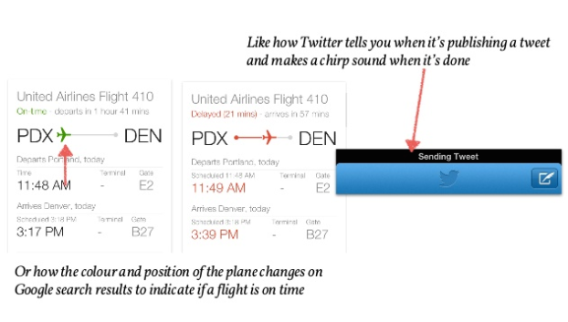
1. VISIBILITY OF SYSTEM STATUS

Slide 35
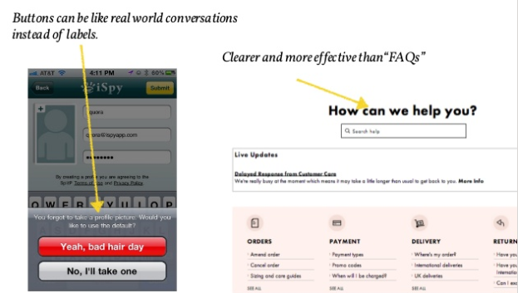
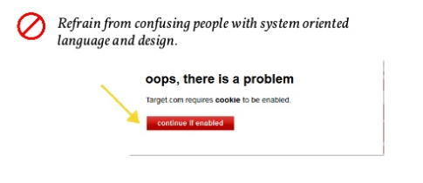
2. MATCH BETWEEN SYSTEM AND THE REAL WORLD
Is there something on your application that a user may not understand? This is very common to miss since we get associated with the product for over a period of time. It’s also important for the application to speak the language of the target user base.
The system should speak the users' language, with words, phrases and concepts familiar to the user, rather than system-oriented terms. Follow real-world conventions, making information appear in a natural and logical order.

Slide 36
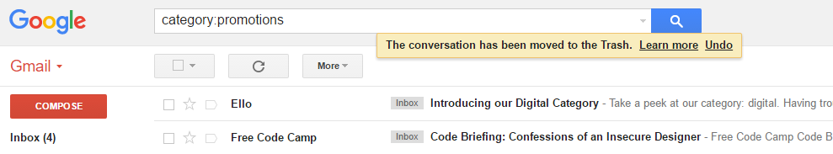
3. USER CONTROL AND FREEDOM
This principle talks about giving the user the freedom to navigate and perform actions. The freedom to undo any accidental actions. This principle can be best illustrated by the Gmail’s flash message with undo action when we accidentally delete an email.

Slide 37
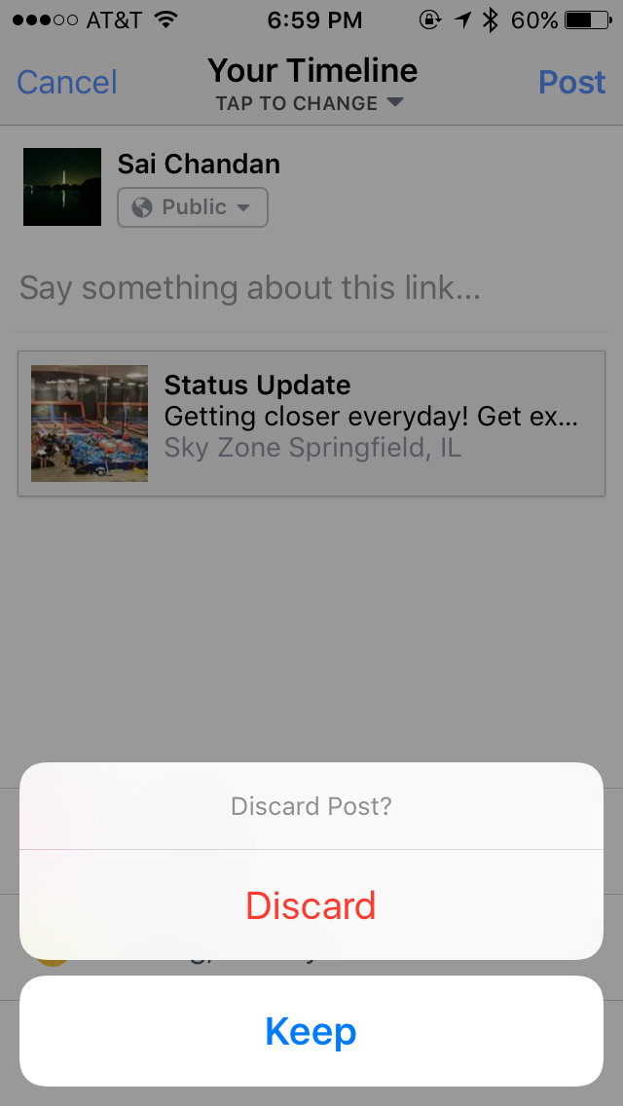
3. USER CONTROL AND FREEDOM

Slide 38

4. CONSISTENCY AND STANDARDS
Consistency is the key. A Submit button in one page should look the same across the site on any page. If we show the data in a particular table format on one page, it should look the same the next time data is being shown in tabular format. If the header is displayed in a certain way on the public pages, it should be the same when he/she logs in.
How the same button can transform across different pages of the same site. Note that this is not a change of state.
Externally, it’s risk-less to follow the standard conventions. A “How It Works” link invokes similar expectation for a user across sites. Google Plus ambitiously launched “+1” to counter Facebook’s “Like” without much success. Facebook’s “Like” already became a standard and sites like LinkedIn adopted it without contesting.

Slide 39
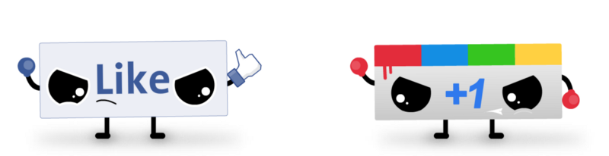
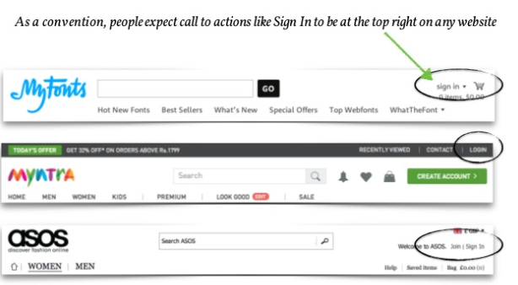
CONSISTENCY AND STANDARDS

Slide 40
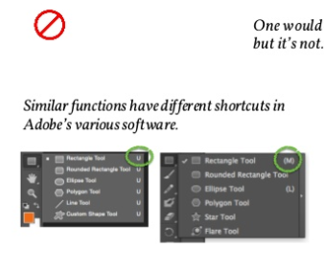
4. CONSISTENCY AND STANDARDS

Slide 41
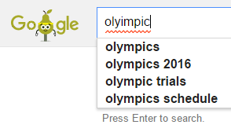
5. ERROR PREVENTION
How many times did your outlook remind you that there is no attachment in the email while you mentioned that something is attached? Outlook intuitively scans the email for such keywords and alerts the user before sending. This is Error Prevention.
Below is an example of Google Search trying to correct my spelling:
If you have set some rules for the format of user password, try to validate it as the user types rather than waiting for him to click submit.

Slide 42
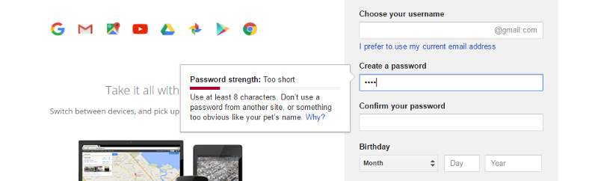
5. ERROR PREVENTION
If you have set some rules for the format of user password, try to validate it as the user types rather than waiting for him to click submit.

Slide 43
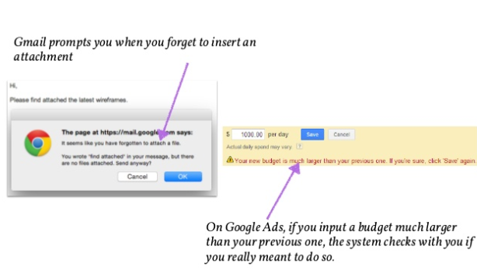
5. ERROR PREVENTION

Slide 44
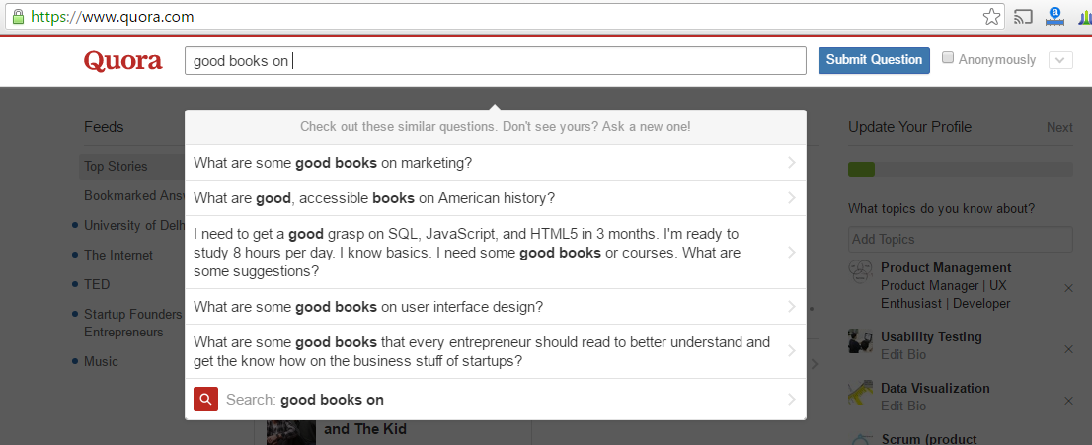
6. RECOGNITION AND RECALL
It’s always better to suggest the user a set of options than to let him remember and type the whole thing. The goal is to minimize the application of user memory.
Below is an example of Quora suggesting possible questions based on what I am trying to type.
One more example is when Quora lets you pick the topics of interest from a list of options rather than asking you to type all of them which would have been disastrous.

Slide 45
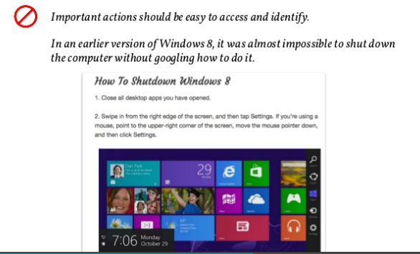
6. RECOGNITION AND RECALL

Slide 46
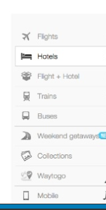
6.RECOGNITION AND RECALL

Slide 47
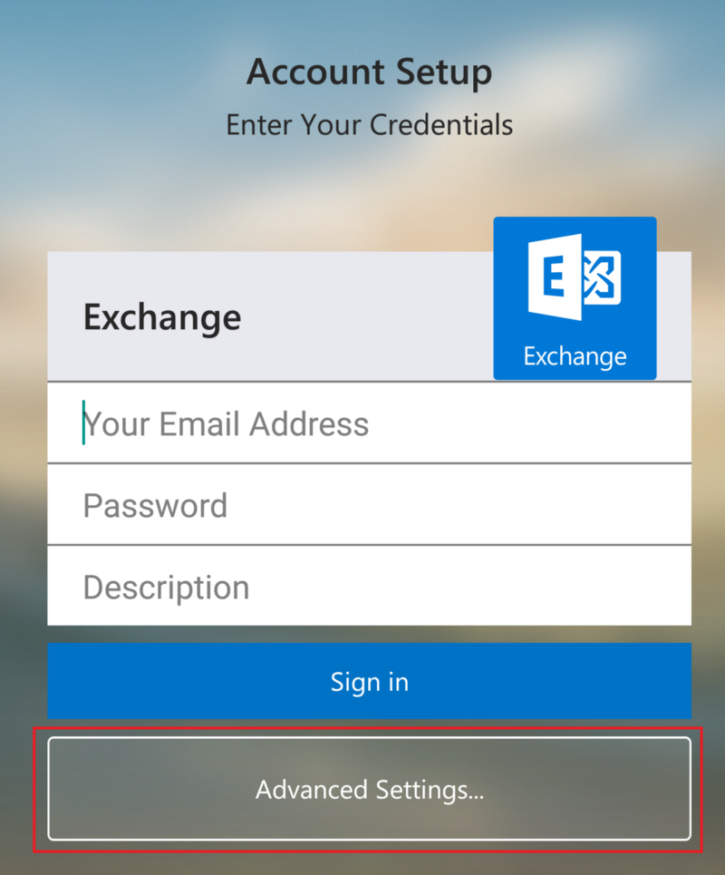
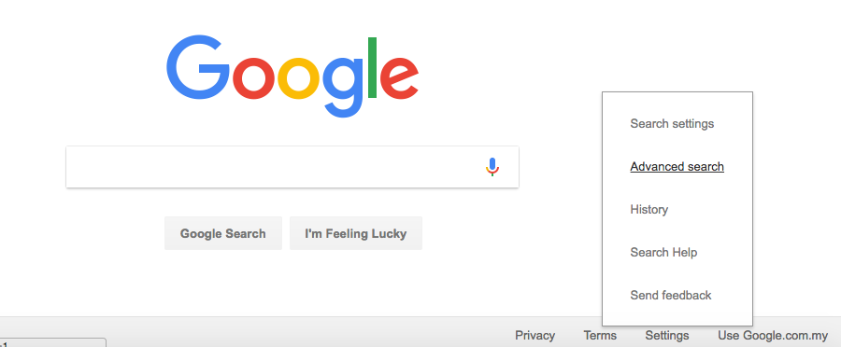
7. FLEXIBILITY AND EFFICIENCY OF USE
7. Flexibility and Efficiency of use:
The Interface should be flexible transforming itself between a novice user and an advanced user. One frequents this option while installing a new software that asks if the user wants to go ahead with default installation or custom installation. An advanced user chooses a custom installation to cut out the unnecessary services.
Below is an example of setting up Exchange on Android which hides the complex features under Advanced.

Slide 48
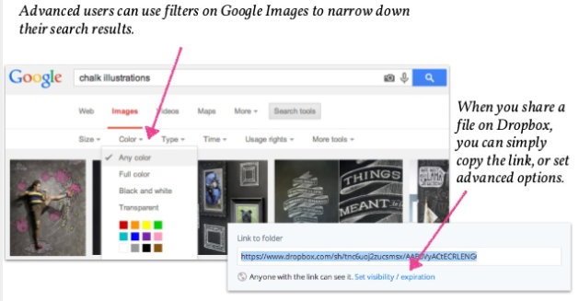
7. FLEXIBILITY AND EFFICIENCY OF USE

Slide 49
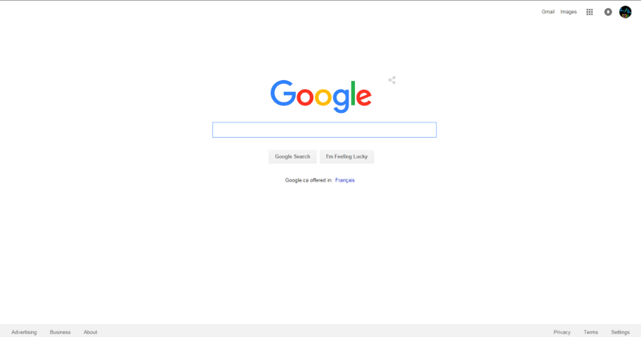
8. AESTHETIC AND MINIMALIST DESIGN
Prioritization comes to play when this aspect is being considered. For the designer or the developer, all the information that’s being presented on the page is relevant. The product manager needs to ask the end user if it is so. Is every information displayed on interface necessary and useful?
Google has been resisting the temptation to show more information on their search page for years. This is could be shown as the example of the best possible minimalist design.

Slide 50
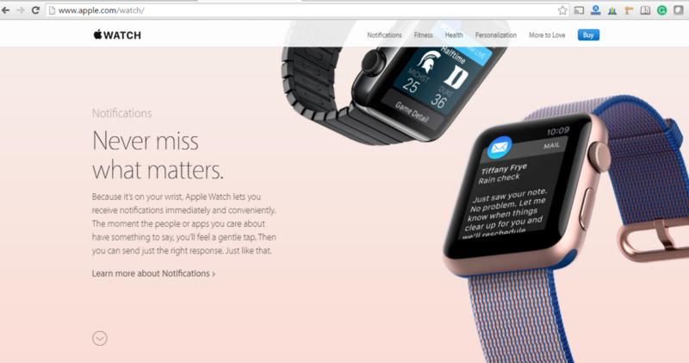
8. AESTHETIC AND MINIMALIST DESIGN
Interfaces need to be cleared of unnecessary elements and content that do not support the page goals and tasks. Apple provides only the basic information of feature hiding additional information under “Learn More”. Check the same product on a retail website to understand the importance of clutter-free experience.

Slide 51
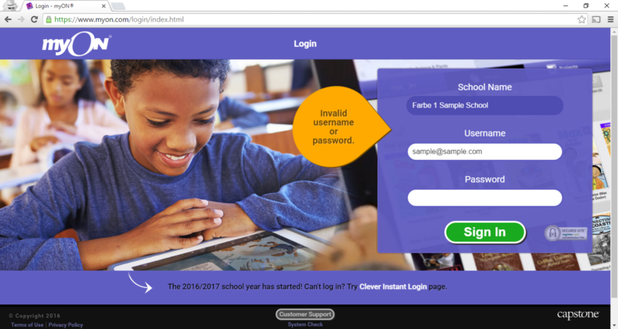
9. HELP USER RECOGNIZE, DIAGNOSE AND RECOVER FROM ERRORS
Errors are inadvertent in the user journey. A check needs to be made if those errors are being explained to the user in understandable language. In the below example, I have entered a fictitious username and password and the error message I got is either the username or the password is incorrect. Here we are not informing the user if the username is invalid or if the password is wrong.

Slide 52
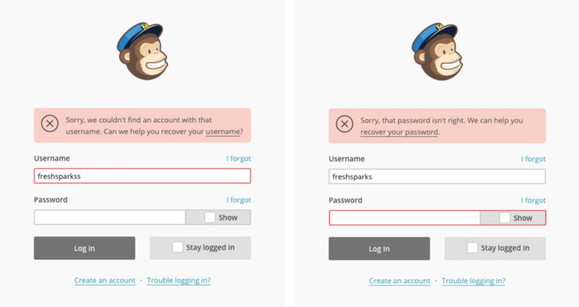
9. HELP USER REVOGNIZE, DIAGNOSE AND RECOVER FROM ERRORS
Below is the example of how MailChimp is handling this scenario:

Slide 53
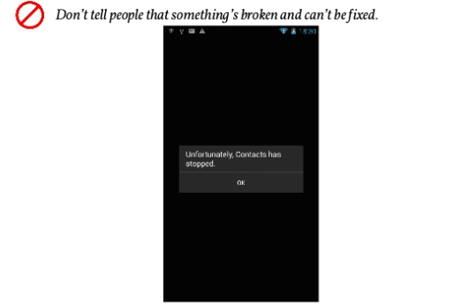
9. HELP USER RECOGNIZE, DIAGNOSE AND RECOVER FROM ERRORS

Slide 54
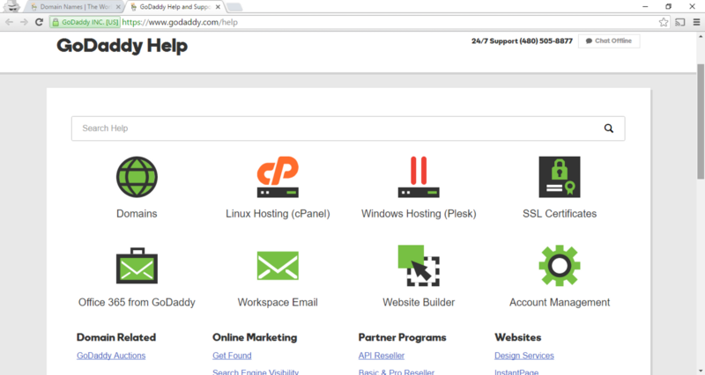
10. HELP AND DOCUMENTATION
If a user has reached this step, something is not right with the interface. A great user interface lets the user navigate through it;s features without any documentation or training. But if there is any user who could not make it out, adequate help should be provided within the product.
Below is an example of GoDaddy’s Help page. While there is a search field, there are main categories and frequently asked queries on the same page.

Slide 55
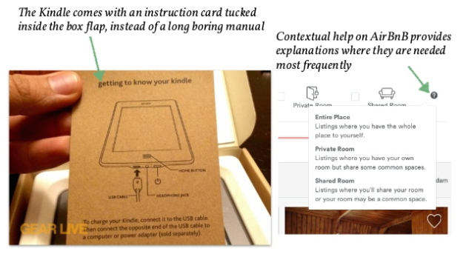
10. HELP AND DOCUMENTATION

Slide 56
Key Points
An evaluation paradigm is an approach that is influenced by particular theories and philosophies
Four categories of techniques were identified: observing users, asking users, asking experts and user testing

Slide 57
Key Points
The DECIDE framework has six parts:
  Determine the overall goals
  Explore the questions that satisfy the goals
  Choose the paradigm and techniques
  Identify the practical issues
  Decide on the ethical issues
  Evaluate ways to analyze & present data
Do a pilot study

